Slide 1
Intro to Natural Language Processing (NLP) Topic modeling Session 3
Mohammad A Al-Mamun, PhD Department of Pharmacy Practice
December 06, 2019

Slide 2
What’ s in a word?
Word processing so far:
Tokenization – segmenting sentences into words
Part-of-speech (POS) tagging – classifying words grammatically
Words have structure:
runs, ran and running are inﬂected forms of the verb run
unfriendly is derived from friendly, which is derived from friend
induce, product and reduction have the same root duc

Slide 3
Morphology
Words are built up of minimal meaningful elements called morphemes: played = play-ed, cats = cat-s, unfriendly = un-friend-ly
Two types of morphemes:
- Stems: play, cat, friend
- Aﬃxes: -ed, s, un-, -ly
Two main types of aﬃxes:
- Preﬁxes precede the stem: un
- Suﬃxes follow the stem: -ed, s, un-, -ly

Slide 4
Why does Morphology matter?
Information Retrieval:
A query for phones should match both phone and phones
Language modeling:
If we have seen scrutinize, we can predict scrutinized
Machine translation:
Swedish bilen corresponds to English the car

Slide 5
Morphemes
• 1 morpheme:
Evitar ( verb to avoid)
• 2 morphemes:
evitable = evitar + able (adj: can be avoided)
• 3 morphemes:
inevitable = in + evitar + able
(adj: cannot be avoided)
• 4 morphemes:
inevitabilidad = in + evitar + able + idad
(noun: cannot be avoided)

Slide 6
Inflectional morphology
Inﬂection relates diﬀerent forms of the same word
The lemma is the canonical form found in dictionaries
Aﬃxation sometimes involves spelling changes (knife – knives)
Inﬂection does not always involve aﬃxation (mouse – mice)
Lemma | Singular | Plural
cat | cat | cats
dog | dog | dogs
knife | knife | knives
sheep | sheep | sheep
mouse | mouse | mice

Slide 7
Inflectional morphology

Slide 8
Derivational Morphology
• Form
• Without change barcelonés
• Prefix inevitable
• Suffix importantísimo
• Source
• verb => adjective tardar => tardío
• verb => noun sufrir => sufrimiento
• noun => noun actor => actorazo
• noun => adjective atleta => atlético
• adjective => adjective rojo => rojizo
• adjective => adverb alegre => alegremente

Slide 9
Derivational Morphology

Slide 10
Word Formation
Morphological processes can be used to form new words
Derivation = stem + aﬃx
friend +-ly = friendly
un- +-friendly = unfriendly
unfriendly +-ness = unfriendliness
Compounding = stem + stem
Rain + coat = Raincoat
Basket + ball = Basketball
Airplane + port = Airport

Slide 11
Morphology - Problems
• Affixes
• Suffixes, prefixes, infixes, interfixes
• Inflectional affixes ≠ derivational affixes
• Derivation implies sometimes a semantic change not always predictable
• Meaning extensions
• Lexical rules
• A derivational suffix can be followed by an inflectional one
• love => lover => lovers
• Inflection does not change POS, sometimes derivation does
• Inflection affects other words in the sentence

Slide 12
Morphological Analysis
token -> lemma + part of speech + grammatical features
Examples:
cats -> cat+N+plur
played -> play+V+past
katternas -> katt+N+plur+def+gen
Often non-deterministic (more than one solution):
plays -> play+N+plur
plays -> play+V+3sg
Lemmatization:
token -> lemma

Slide 13
Morphological Analysis
• Decompose a word into a concatenation of morphemes
• Usually some of the morphemes contain the meaning
• One (root or stem) inflection and derivation
• More than one in composition
• The other (affixes) provide morphological features

Slide 14
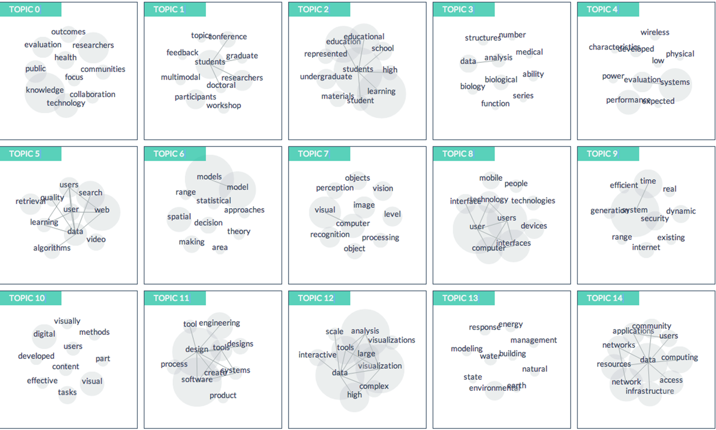
Topic Modelling

Slide 15
Topic Modelling
Topic modelling provides an algorithmic solution to managing, organizing and annotating large archival text.
The annotations aid you in tasks of information retrieval, classification and corpus exploration.
Topic models provide a simple way to analyze large volumes of unlabeled text.
A “topic” consists of a cluster of words that frequently occur together. Using contextual clues, topic models can connect words with similar meanings and distinguish between uses of words with multiple meanings.

Slide 16
Making Sense of Text
Suppose you want to learn something about a corpus that’s too big to read
• What topics are trending today need to make sense of…
on Twitter? • half a billion tweets daily
• What research topics receive
grant funding (and from whom)? • 80,000 active NIH grants
• What issues are considered by
Congress (and which politicians
are interested in which topic)? • hundreds of bills each year
• Are certain topics discussed more
in certain languages on Wikipedia? • Wikipedia (it’s big)

Slide 17
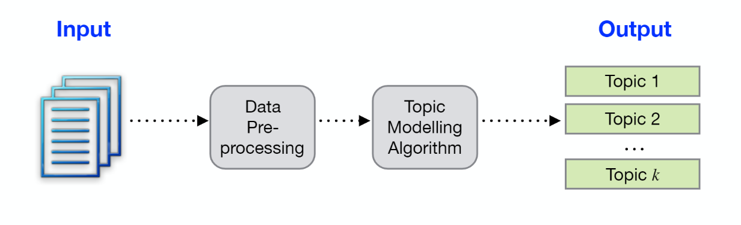
Topic Models
Topic models can help you automatically discover patterns in a
corpus
• unsupervised learning
Topic models :
• group topically-related words in “topics”
• associate tokens and documents with those topics

Slide 18
What is a “topic”?
• Loose idea: a grouping of words that are likely to appear in the same
context
• A hidden structure that helps determine what words are likely to appear in
a corpus
• The underlying structure is different from what you’ve seen before – it’s
not syntax
• E.g. if “war” and “military” appear in a document, you probably won’t be
surprised to find that “troops” appears later on.

Slide 19
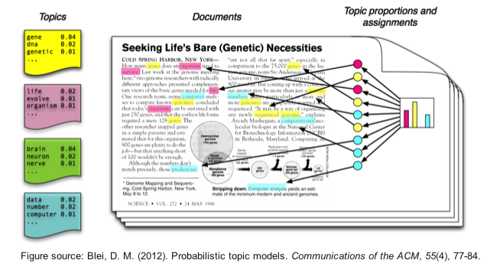
What is a “topic”?

Slide 20
Latent Dirichlet Allocation (LDA)
Topic Modelling Algorithm
Technique that facilitates the automatic discovery of themes in a collection of documents.
Basic assumption is that each of the documents in a collection consist of a mixture of collection-wide topics.
In reality, only documents and words, not topics – the latter are part of the hidden (or latent) structure of documents.
The aim is to infer the latent topic structure given the words and document document.
LDA does this by recreating the documents in the corpus by adjusting the relative importance of topics in documents and words in topics iteratively.

Slide 21

Topic Modelling – An Example
Investigating the top topics in the “acq” dataset which is a collection of 50 news articles with additional meta information from the Reuters data set.

Slide 22
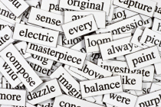
Step 1 – Data Loading
Load the data from the tm package
in R.
Verify that the data is in the form of
a vector corpus in order to apply the
text mining functions.

Slide 23
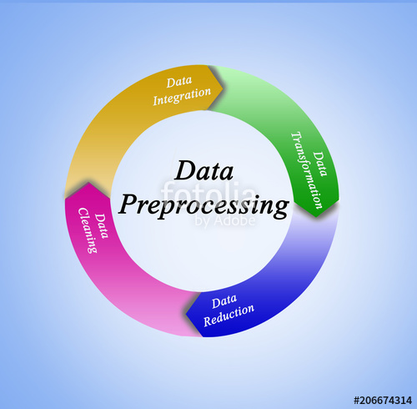
Step 2 – Pre-processing data
Transform to lower case
Exclude punctuation
Remove the numbers
Eliminate stop words
Take out whitespace
Stem the corpus

Slide 24
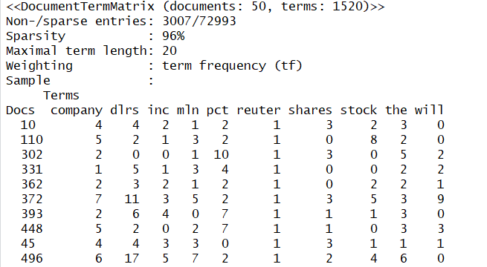
Step 3 – Model Building
Create a Document Term Matrix (DTM)
to develop the topic model.
A document-term matrix or
term-document matrix is a
mathematical matrix that describes the
frequency of terms that occur in a
collection of documents.
In DTM, rows correspond to documents
in the collection and columns to terms.
Usually implemented as sparse matrices.

Slide 25
Step 4 – Implementing the Model
We use the topicmodels package in R.
Set a seed so that the output of the model is predictable
Choose the ideal k, the number of topics.
Run the LDA algorithm on the Document – Term matrix.
Two important results that we need from the LDA function are:
Topic concentration / Beta
Document concentration / Alpha

Slide 26
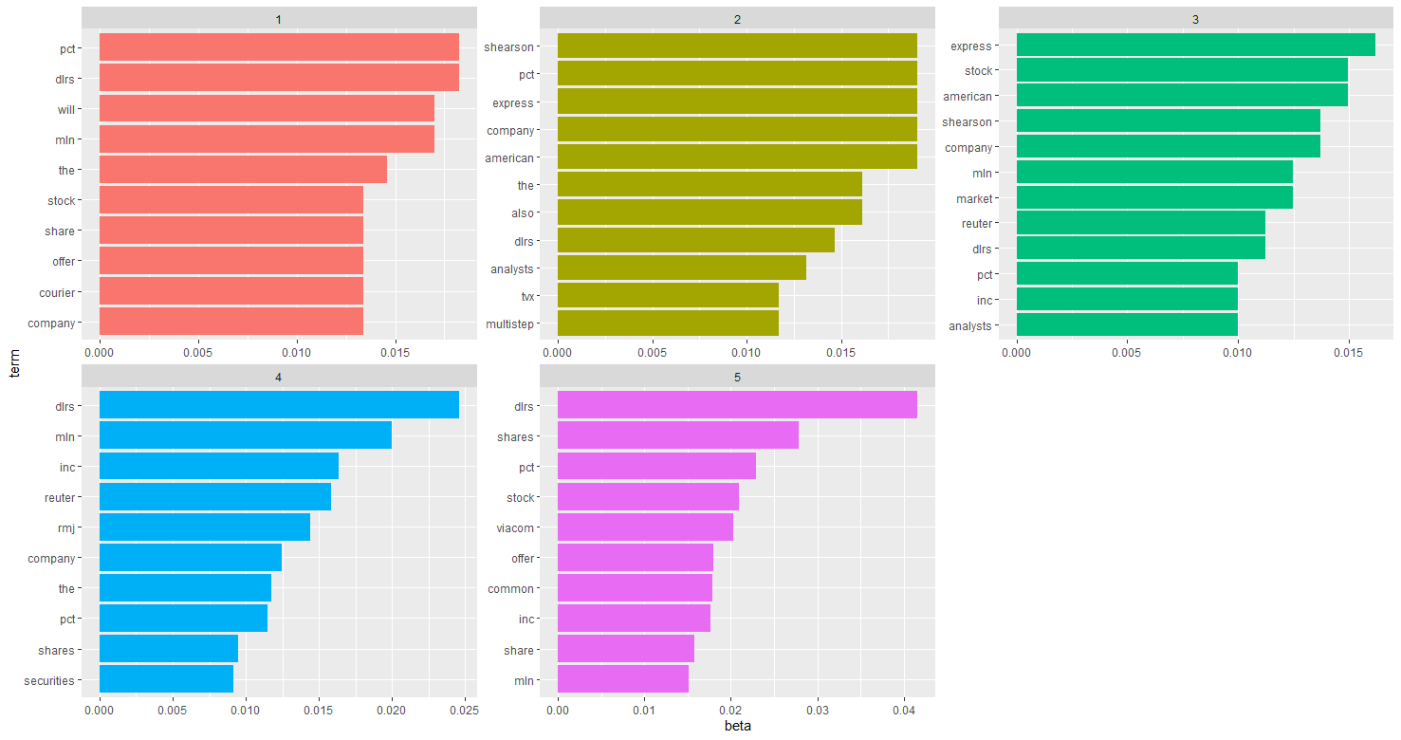
Step 5 – Analyze Results
Most common topics
in the corpus

Slide 27
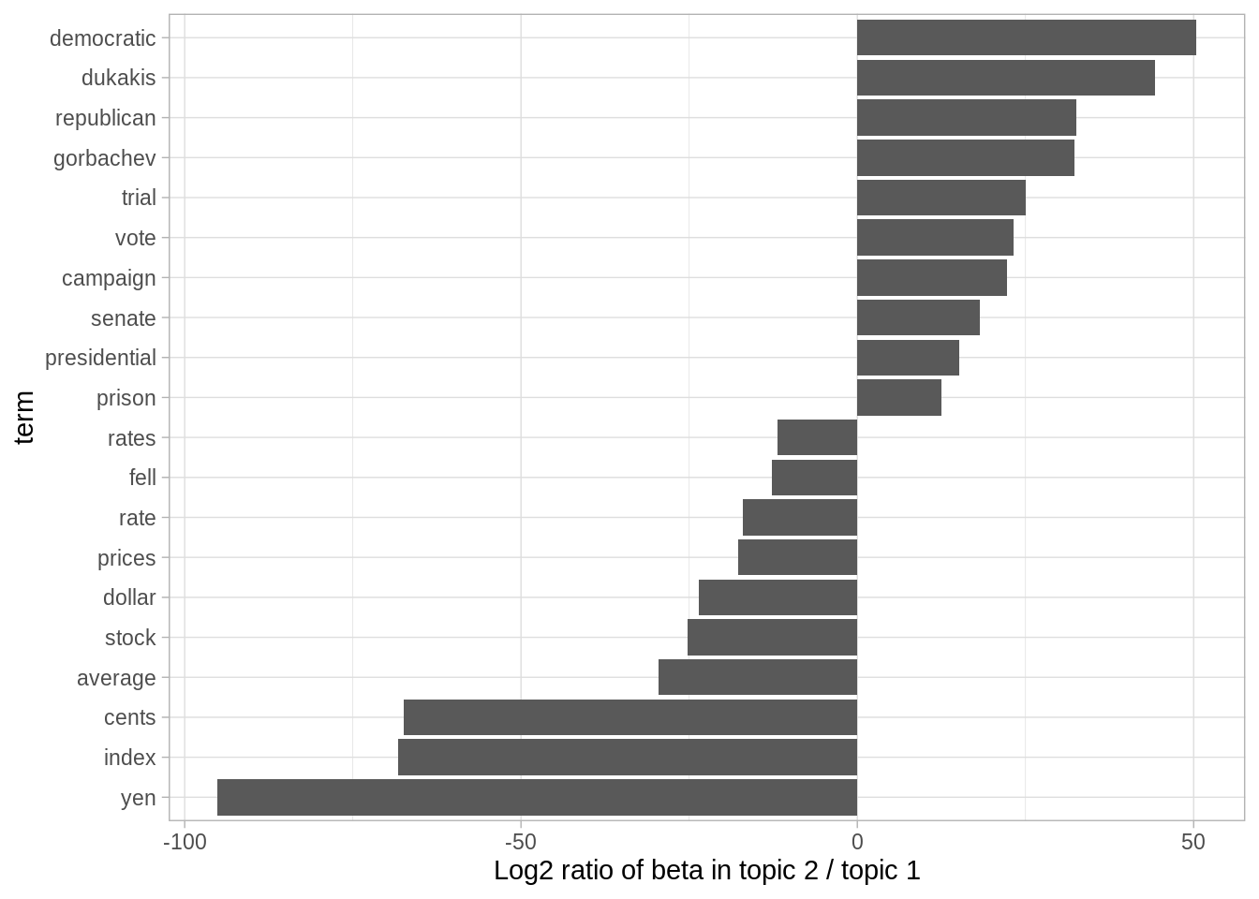
Step 5 – Analyze Results
Words with the greatest differences between two topics

Slide 28
Session 3 - R Hands-On

Slide 29
References
Data Science and Big Data Analytics - by EMC
Text Mining with R – by Julia Silge and David Robinson

